Slide 1
Instructions for Visualization and Analysis Demos
You have 3 minutes to present – be ready to share your screen, practice first. We can only offer you one opportunity to present. Present your slides in “Slide Show” mode. Presentations will take place during the module Tutorial slots (see Canvas Announcements for links to join Tutorials via Teams).
The next few slides give you all the alternatives for how to present your Visualizations. You will select only one as fits your RQ. Before presenting DELETE all text (and instructions) that you do not use (including this slide). You can then enlarge your selection, so it is clearly visible on the slide.
Appointment slots will appear on Canvas soon (calendar-7com1079-24). Sign up early. When space runs out, we cannot issue any further slots for this week. If you do not turn up for your slot you will not be given another opportunity. Ideally, all the group members should attend but select one person to present. DO NOT SIGN UP unless one of your group can attend and present. You will not be graded on this.
We look forward to giving you feedback. If your group is not presenting, still attend the tutorial as the feedback will help you too.
¹At this point we assume you are using your allocated datasets (see group-dataset allocations on Slack Announcements). Any changes to the Kaggle/Data.world csv/xlxs file you make such as merges, grouping, or size reduction must be done via an R script, not manually, not in excel.

Slide 2
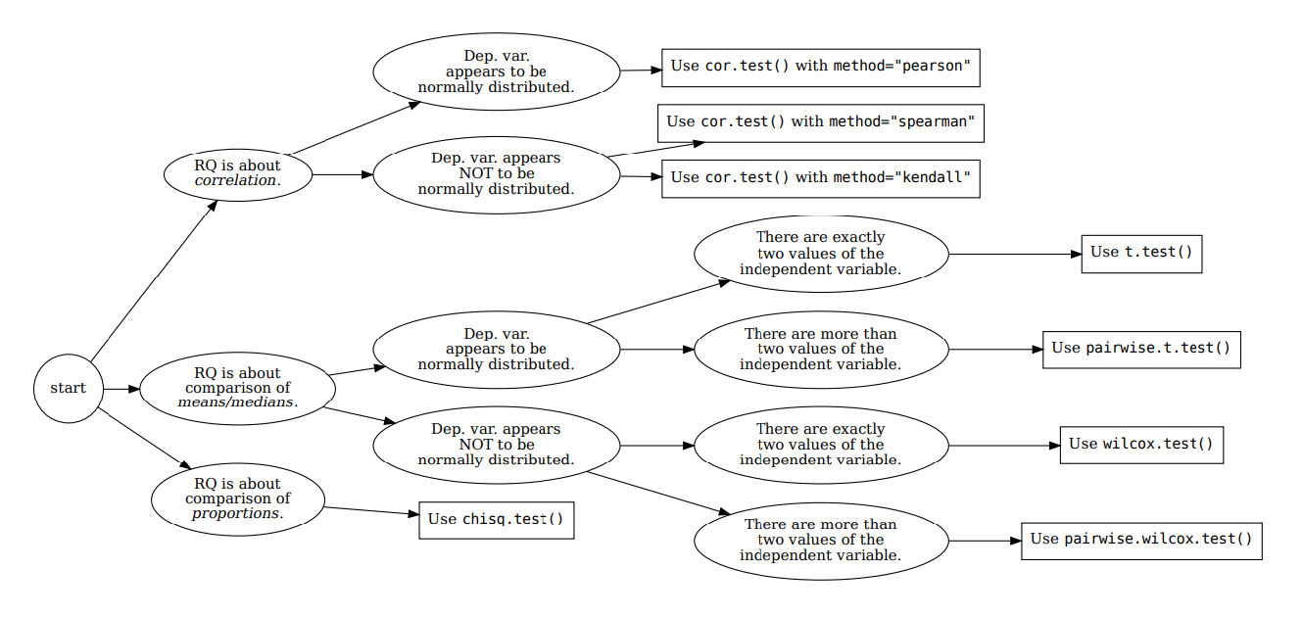





How your RQ + distribution of data (Histogram) leads to a statistical test. Visualization requirements highlighted in yellow.
Histogram & Scatterplots
Histogram and Boxplots
Stacked bar chart (no histogram)
Figure: Decision tree – how Research Questions relate to Visualizations and Statistical Test.

Slide 3

Visualization and Analysis –
Tutorial Presentation for Feedback
Date:
Group Id: A172 Name of Student Presenting:

Slide 4
our reasearch question: “Is there a difference in the mean of Critic score of vedio games between the “Nintendo publisher “and Other Publishers “.
Null hypothesis (H₀): There is no difference in the mean of the Critic score between/among subsets of the Publishers.
Alt hypothesis (H₁): : There is difference in the mean of the Critic score between/among subsets of the Publishers.
Part 1: VISUALISATION

Slide 5
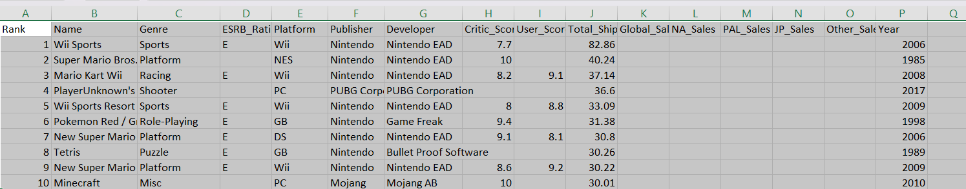

Slide 6
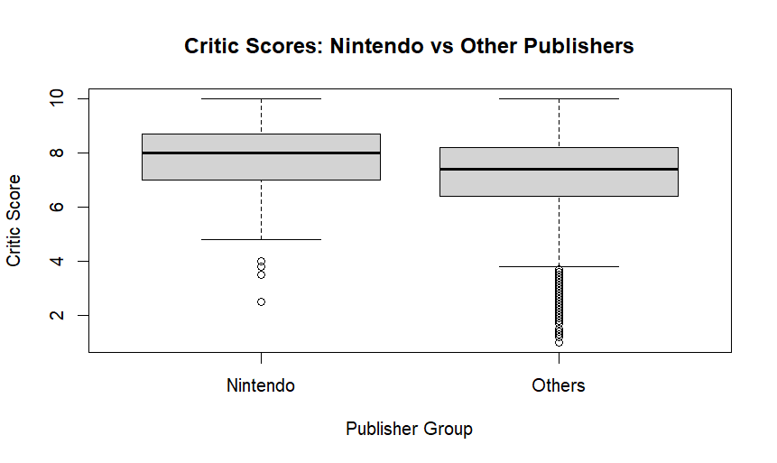
Comparison of means/medians
BOXPLOT
df$Critic_Score <- as.numeric(df$Critic_Score)
df_compare <- df %>% mutate(Group = ifelse(Publisher == "Nintendo", "Nintendo", "Others"))
avg_scores <- df_compare %>% group_by(Group) %>% summarise(avg_cs = mean(Critic_Score, na.rm = TRUE))
boxplot( Critic_Score ~ Group, data = df_compare, main = "Critic Scores: Nintendo vs Other Publishers", xlab = "Publisher Group", ylab = "Critic Score")
Comparison of means (or medians) analyses the difference between the mean (or median) value of a characteristic shared by members of two (or more) different populations/values.

Slide 7
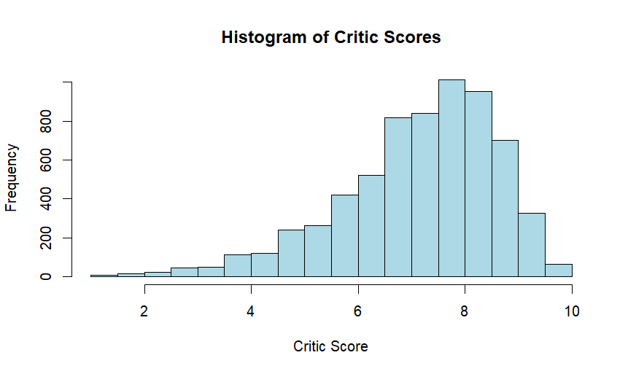
HISTOGRAM
hist(df_compare$Critic_Score,
main = "Histogram of Critic Scores",
xlab = "Critic Score",
ylab = "Frequency",
col = "lightblue",
border = "black")

Slide 8
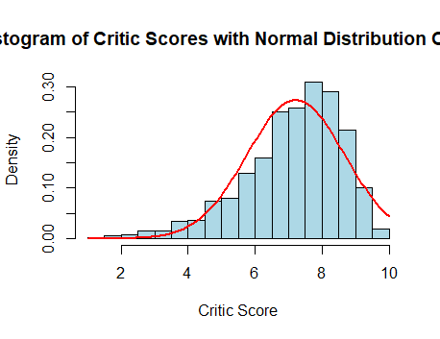
Here is a Histogram showing the frequencies of our dependent variable to include the normal curve overlay (shown in blue).
Our RQ asks about Differences in means/ medians
hist(df_compare$Critic_Score,
main = "Histogram of Critic Scores with Normal Distribution Overlay",
xlab = "Critic Score",
ylab = "Density",
col = "lightblue",
border = "black",
freq = FALSE) # Use density scale
curve(dnorm(x,
mean = mean(df_compare$Critic_Score, na.rm = TRUE),
sd = sd(df_compare$Critic_Score, na.rm = TRUE)),
col = "red",
lwd = 2,
add = TRUE)
8

Slide 9
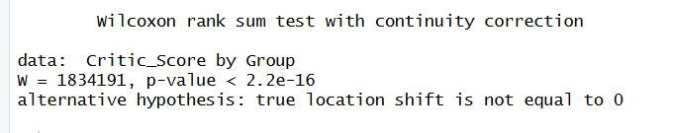
R Script and Results (For ALL types of test) – The Analysis
PRE 7COM1079-2022 Student Group No: ?????
9
R CODE
  df_compare <- df %>% mutate(Group = ifelse(Publisher == "Nintendo", "Nintendo", "Others"))
  wilcox.test(Critic_Score ~ Group, data = df_compare)
Wilcoxon Rank-Sum Test Results
Test Used: Wilcoxon Rank-Sum Test
Test Statistic (W): 1,834,191
p-value: < 2.2 × 10⁻¹⁶
Significant?: Yes
Decision: Reject the null hypothesis
Conclusion:
Nintendo games have significantly different critic scores compared to other publishers. Publisher appears to be associated with critic ratings.
Notes:
9

